Slide 1
Our State Budget: Building a Better Future Together
Massachusetts Budget and Policy Center
15 Court Square, Suite 700, Boston, MA 02108
617.426.1228
www.massbudget.org

Slide 2
Education

Slide 3
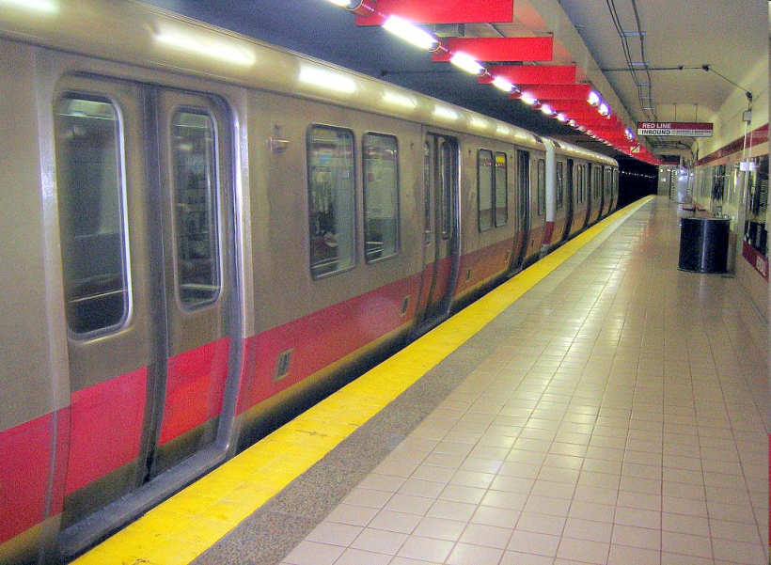
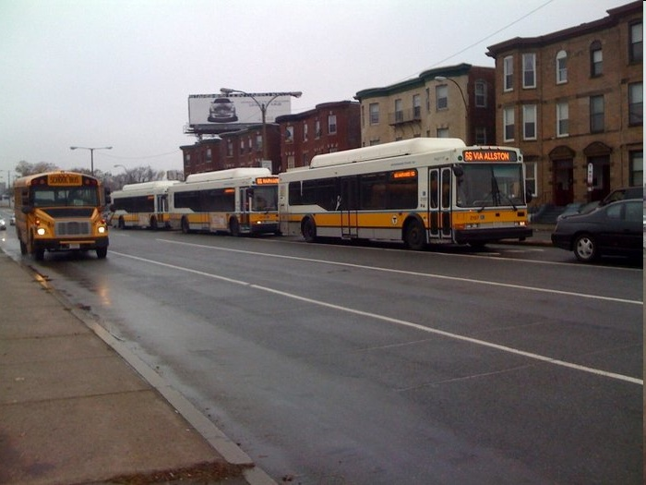
Transportation
Notes:
…helps us get where we need to go, whether we’re driving or using public transportation…

Slide 4
Libraries, Parks and Recreation

Slide 5
Public Safety

Slide 6
Clean Air and Safe Drinking Water
Notes:
protect our drinking water and natural habitats…

Slide 7
Prisons and the Courts

Slide 8
Health Care and Public Health
Notes:
…ensure access to affordable health care and services…

Slide 9
Human Services

Slide 10
What Percent of our Income Funds these Programs?

Slide 11
Taxes as Percent of Personal Income, 2011
State and Local Taxes 10.4%

Slide 12
Mass. Taxes are About Average, 2011
US 10.6%
MA 10.4%
Notes:
As you can see in this slide, in MA we use less of our available economic resources – less of the total income generated in the state - for state and local government programs than do most other states. * Alaska’s high tax-to-income ratio (of 20.8%) is in large part the result of “severance taxes” charged to oil companies for the extraction of this natural resource.
So, if we are a relatively low tax state, how did we get the name “Taxachusetts”?
Sales Tax Increase
Since fiscal year 2009, MA has increased a few taxes, most notably the sales tax.
Other states also have increased their taxes during the course of the Great Recession due to budget shortfalls. So, even if MA has risen in the rankings, we still very likely are below the national average.

Slide 13
Why We are Called “Taxachusetts”
Fiscal Year 1977
MA 13.8%
US 11.4%
Notes:
As you can see in this slide, in MA we use less of our available economic resources – less of the total income generated in the state - for state and local government programs than do most other states. * Alaska’s high tax-to-income ratio (of 20.8%) is in large part the result of “severance taxes” charged to oil companies for the extraction of this natural resource.
So, if we are a relatively low tax state, how did we get the name “Taxachusetts”?
Sales Tax Increase
Since fiscal year 2009, MA has increased a few taxes, most notably the sales tax.
Other states also have increased their taxes during the course of the Great Recession due to budget shortfalls. So, even if MA has risen in the rankings, we still very likely are below the national average.

Slide 14
MA Taxes Among Largest Declines: 1977- 2011
US 7.3%
Decrease
MA 25.0%
Decrease
Notes:
Essential:
As you can see here, over the three decades from 1977 to 2009, MA cut taxes as a share of total economic resources more than any other state.
Optional:
Again, since 2008, MA has increased a few taxes, most notably the sales tax.
Other states also have increased their taxes during the course of the Great Recession due to budget shortfalls. So, if MA has risen in the rankings, we still very likely are below the national average.
Review and transition:
So, that is a quick look at where MA stands in terms of levels of taxation relative to other states. In the next slide we’ll look more closely at the period since 1998 and see how tax cuts have affected overall state revenue collections.

Slide 15
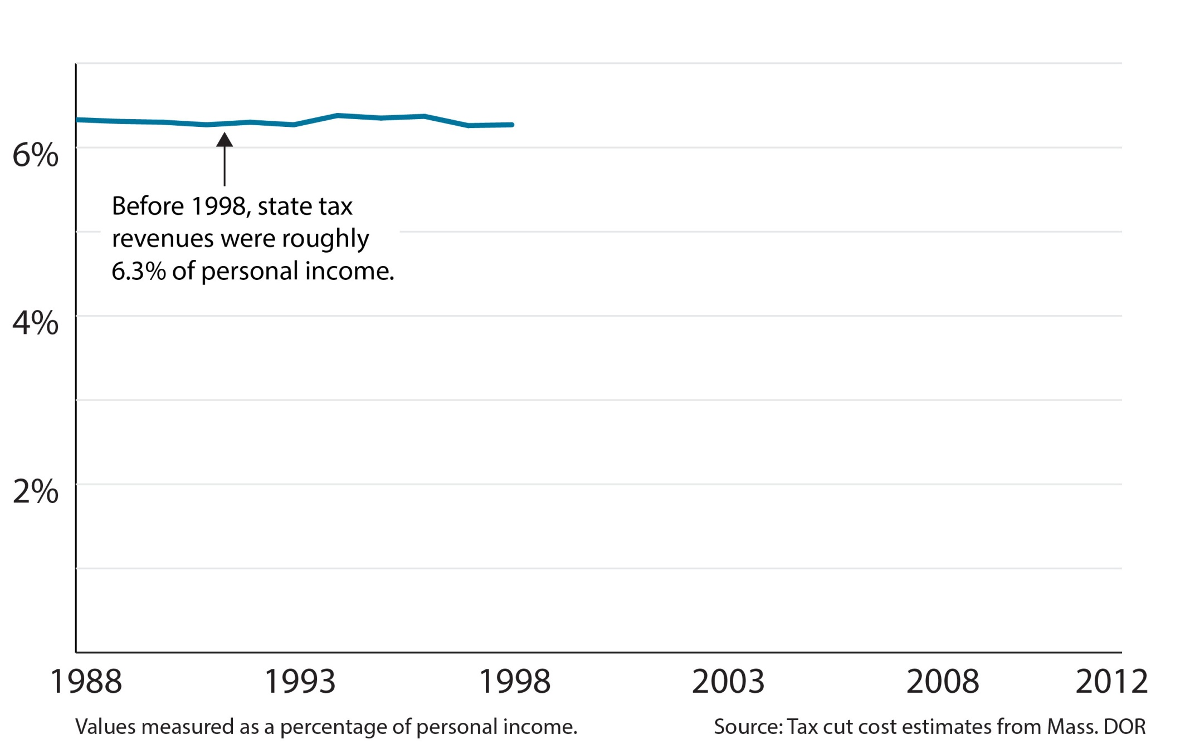

Slide 16
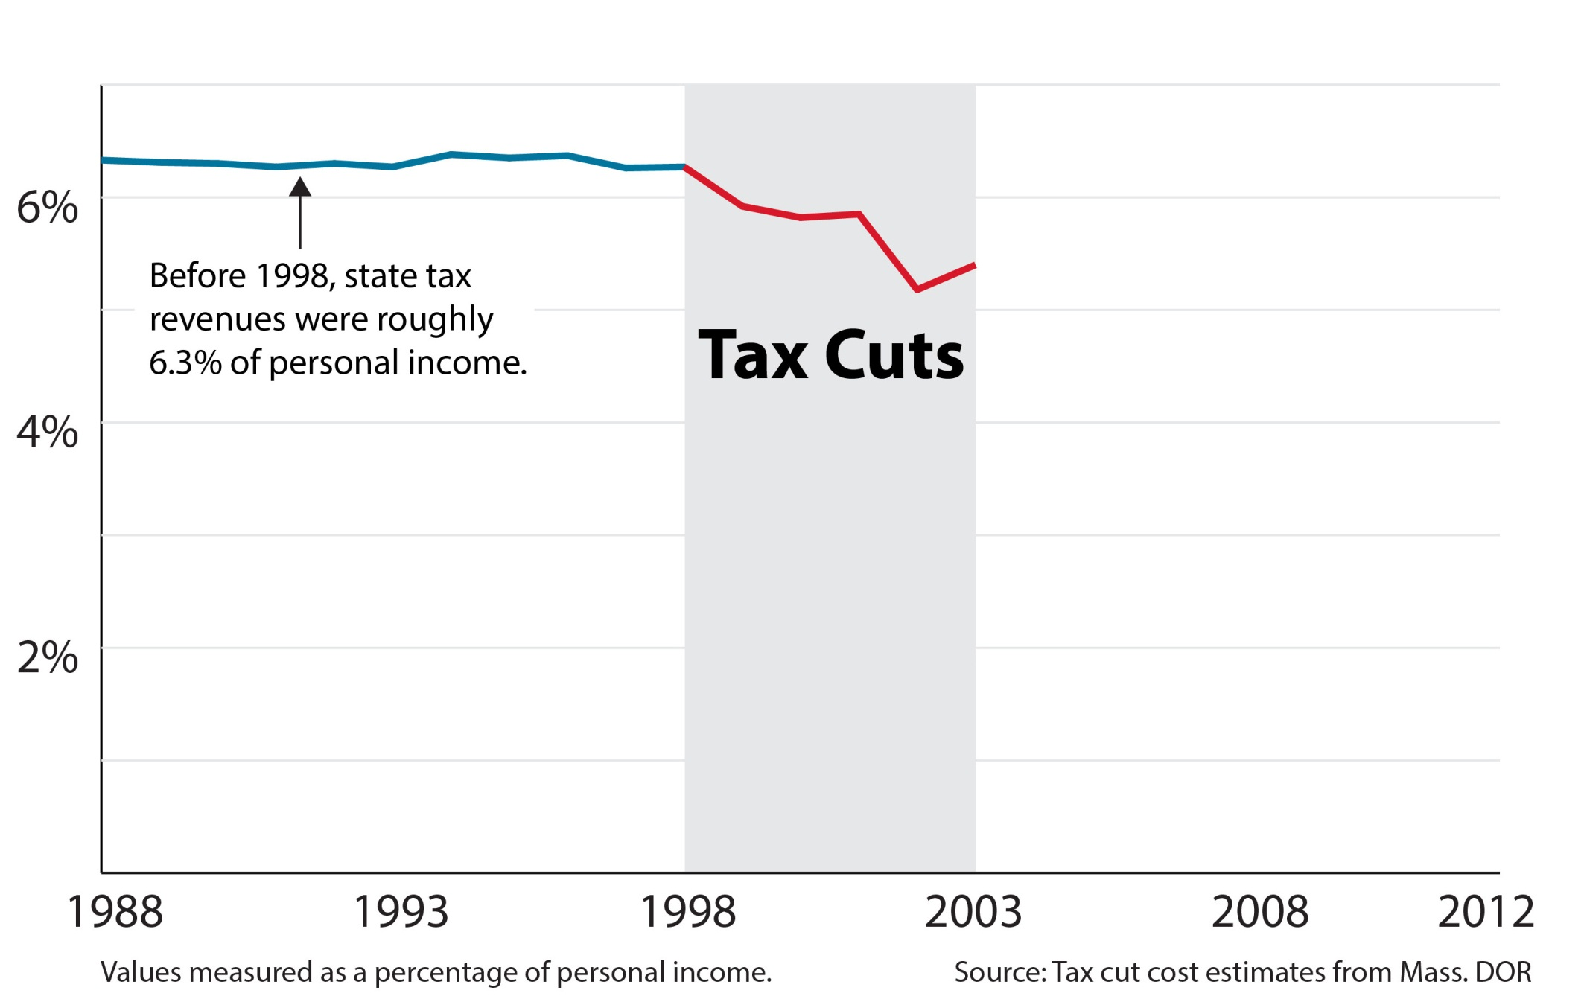

Slide 17
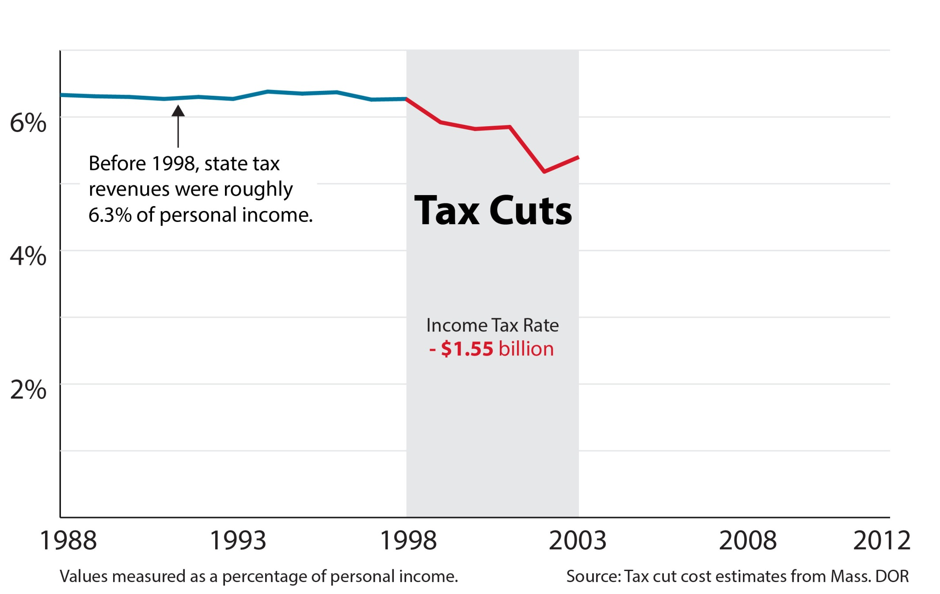

Slide 18
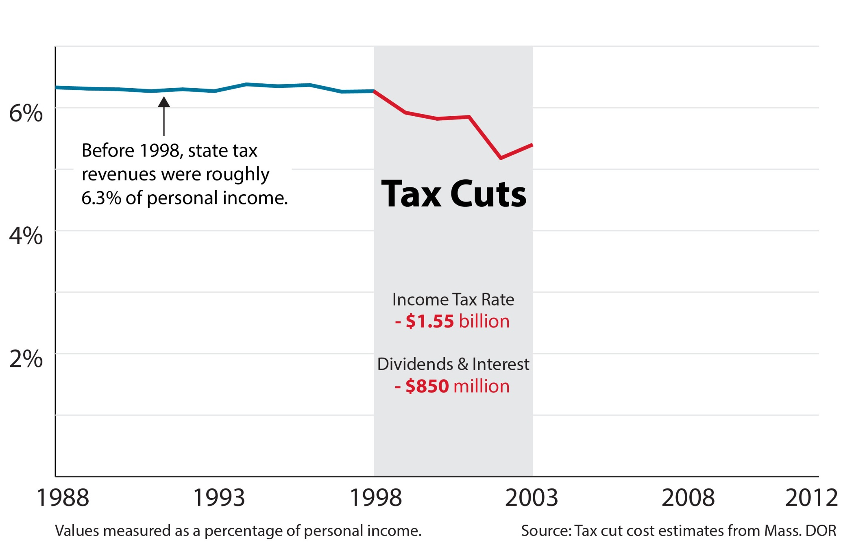

Slide 19
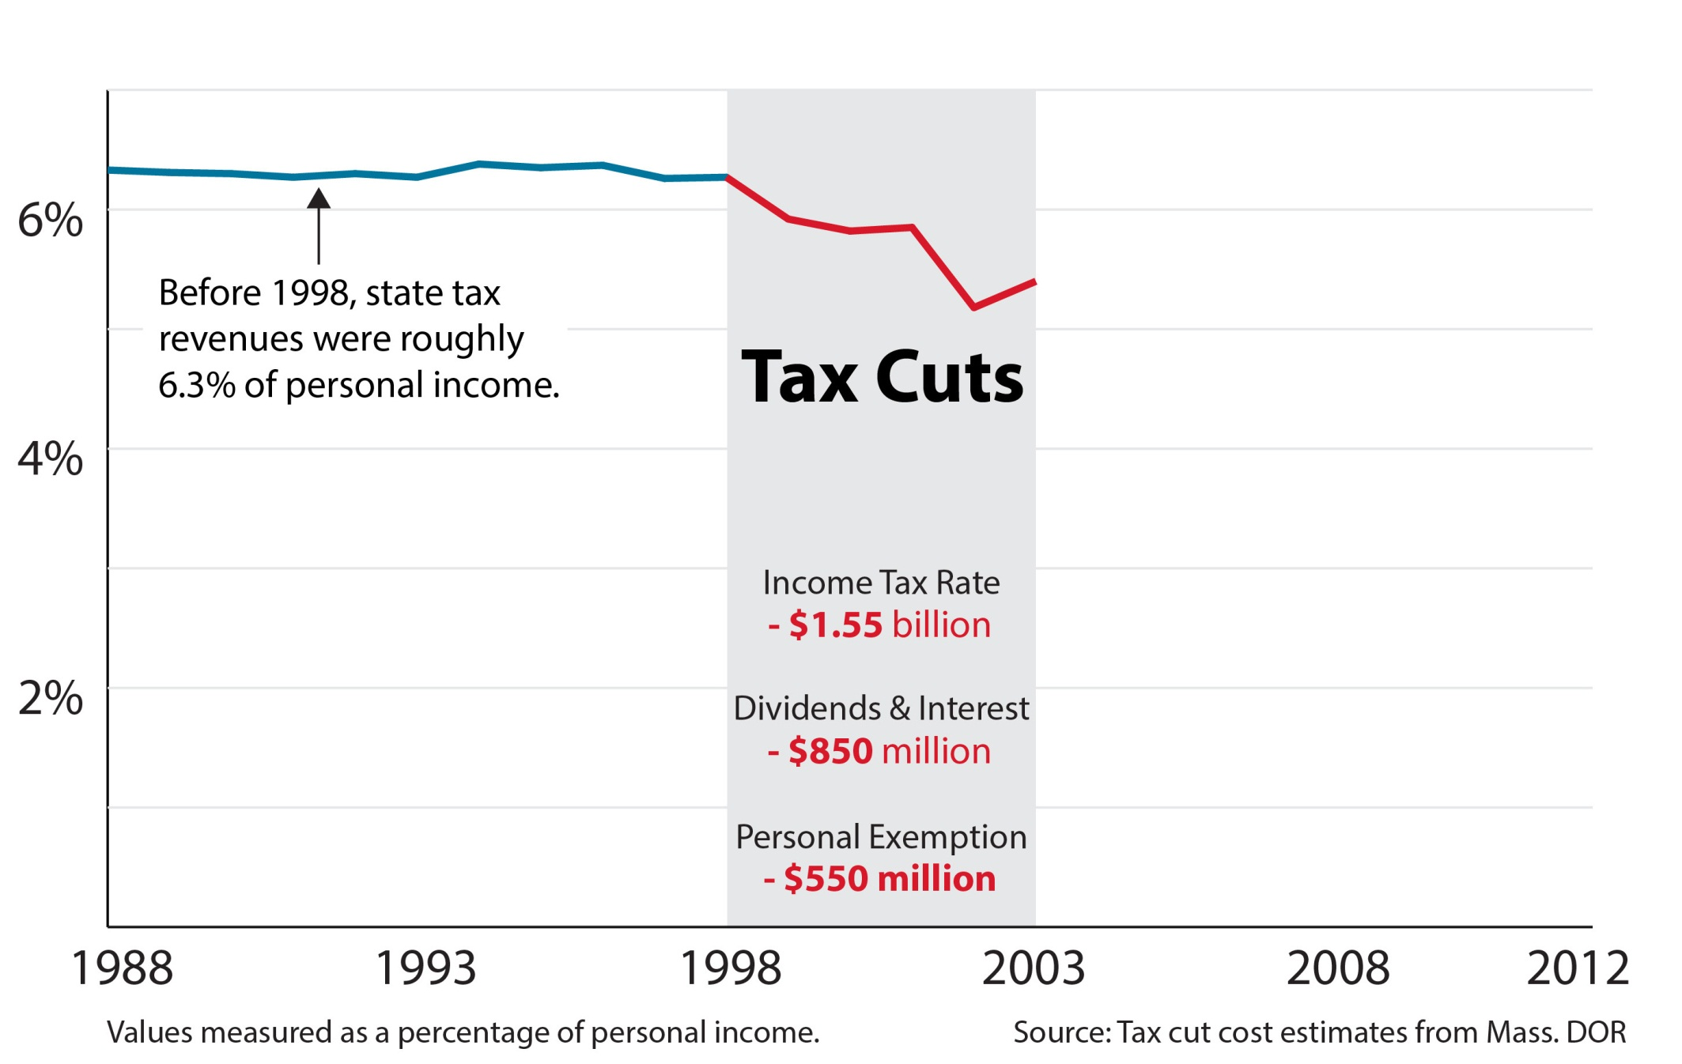

Slide 20
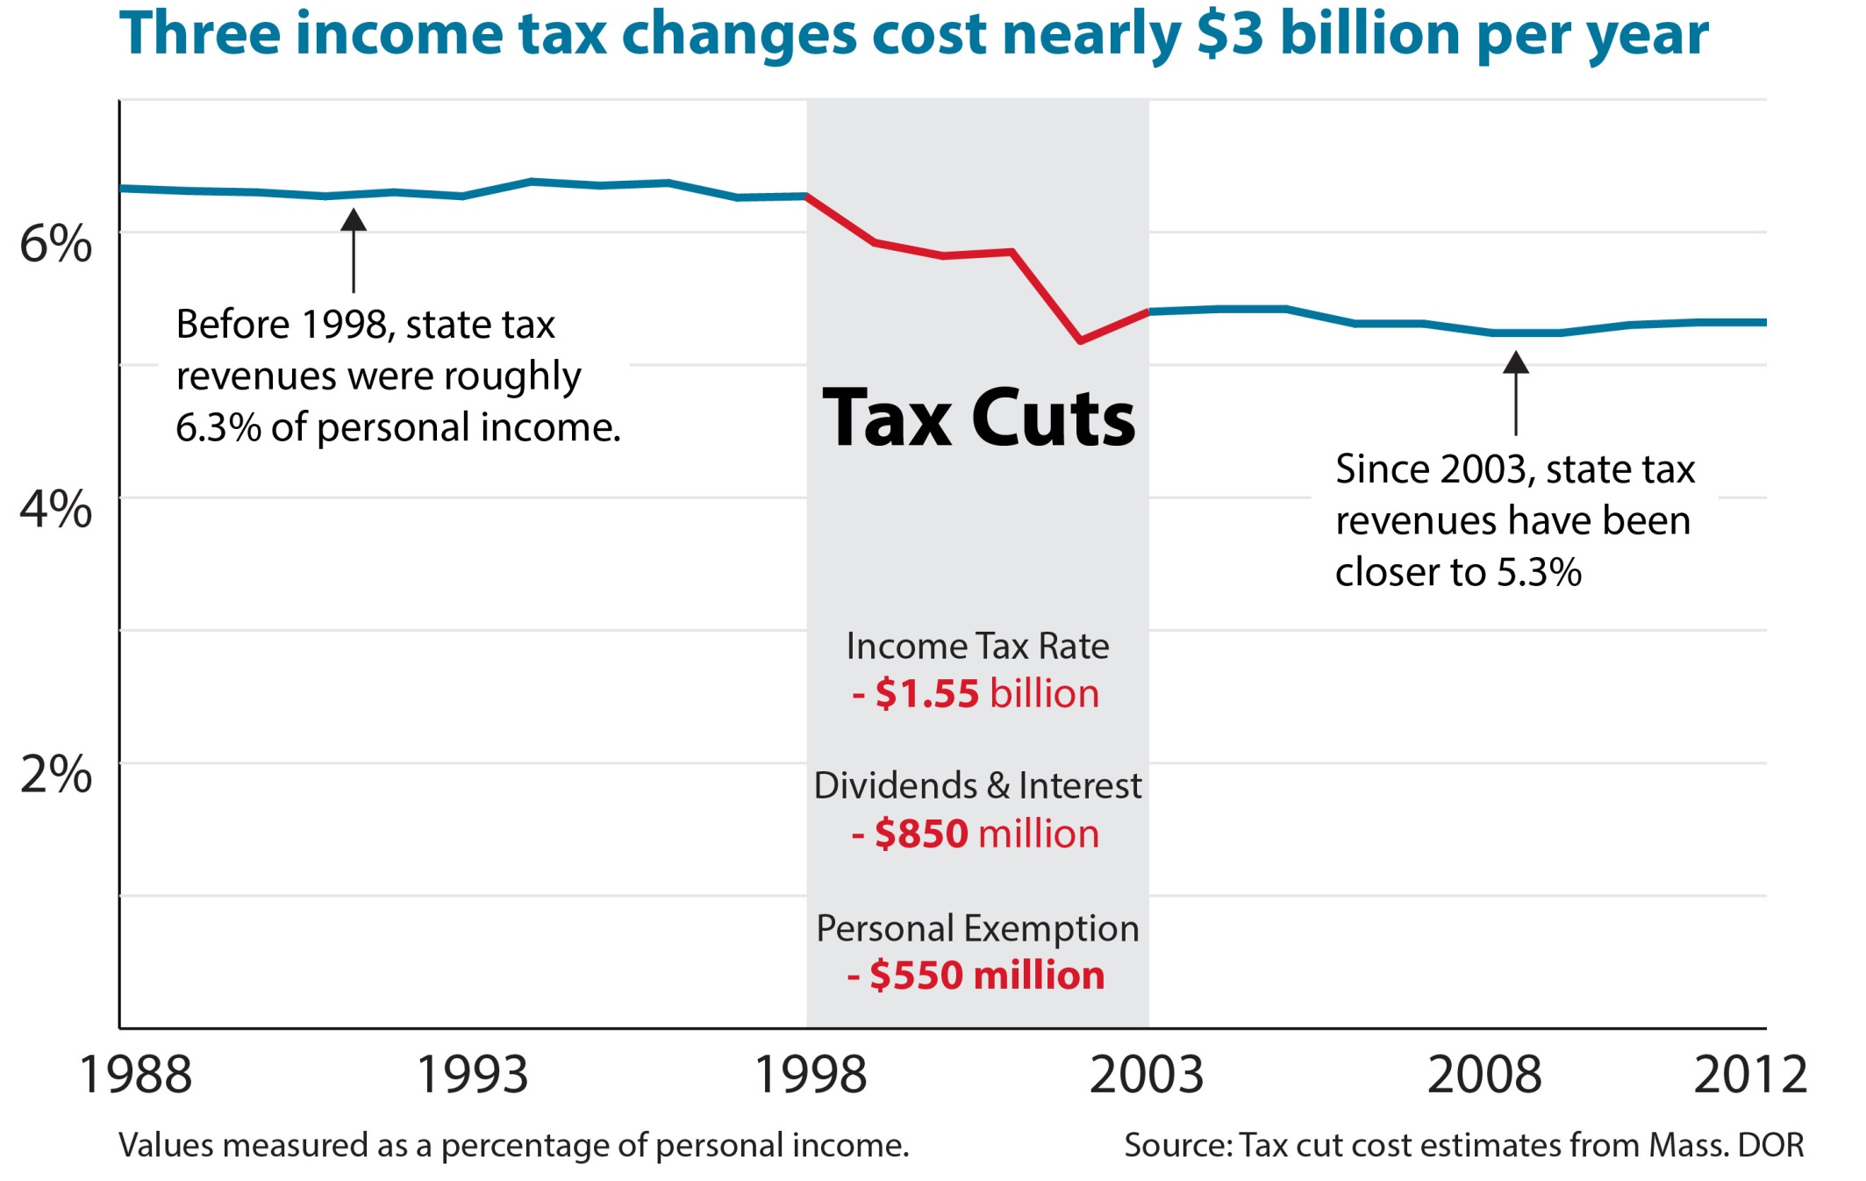

Slide 21
Tax Cuts Have Affected Services
Notes:
Slide 20 (5 seconds)
Tax cuts and the resulting drop in revenues have led to multiple rounds of budget cuts to all kinds of state programs.

Slide 22
Chapter 70 Education Aid
Billions, Inflation Adjusted
4.4% decrease since FY01
Includes ARRA funding; Adjusted using the inflation factor identified in Chapter 70

Slide 23
Local Aid
Billions, Inflation Adjusted

Slide 24
Early Education and Care
Millions, Inflation Adjusted

Slide 25
Higher Education
Billions, Inflation Adjusted

Slide 26
Public Health
Millions, Inflation Adjusted

Slide 27
Human Services
Billions, Inflation Adjusted

Slide 28
Mental Health
Millions, Inflation Adjusted
12% decrease since FY01 Some costs shifted

Slide 29
Environment and Recreation
Millions, Inflation Adjusted
35% decrease since FY01

Slide 30
A Tax System Should Be . . .
Adequate
Stable
Simple/Efficient
Fair

Slide 31
The Sales Tax is Regressive
Income Range: | Lowest 20% | Second 20% | Middle 20% | Fourth 20% | Next 15% | Next 4% | Top 1%
Top 20%

Slide 32
Why the Sales Tax is Regressive
Lowest 20% | Second 20% | Middle 20% | Fourth 20% | Top 20%
Source: Bureau of Labor Statistics, Consumer Expenditures Survey, 2008

Slide 33
The Property Tax is Regressive
Income Range: | Lowest 20% | Second 20% | Middle 20% | Fourth 20% | Next 15% | Next 4% | Top 1%
Top 20%

Slide 34
The Income Tax is Progressive
Income Range: | Lowest 20% | Second 20% | Middle 20% | Fourth 20% | Next 15% | Next 4% | Top 1%
Top 20%

Slide 35
State and Local Taxes are Regressive
Income Range: | Lowest 20% | Second 20% | Middle 20% | Fourth 20% | Next 15% | Next 4% | Top 1%
Top 20%

Slide 36
Investing in a strong state economy

Slide 37
No Clear Relationship Between Tax Levels & Wages, 2012
Notes:
WHILE PREVIOUS SLIDE STILL UP:
The obvious question this all leaves us with is: does this work? Does investing $700 mil a year in tax breaks help improve the state economy?
Mostly, we really don’t know, because there isn’t any good data on effectiveness of each specific tax break, but there is some pretty compelling data on the effect of taxes overall.
First let’s look at the relationship between total taxes and wages.
__________________
One good measure of a state’s economic strength is whether or not the economy is delivering good wages for working people.
(Show what different trendlines would look like)
So let’s see what this shows us…ABSOLUTELY NOTHING
This is consistent with most economic literature. Other factors are more important to the strength of the economy than taxes.
Also, if you think about it, taxes that are taken in by the state go back out in the form of hiring and providing services that contribute to the economy.
_________________________________________
Let’s now swap in education for taxes and see if we observe a similar story.

Slide 38
Strong Relationship Between Education and Wages, 2012
Notes:
States with better-educated workers have stronger, more vibrant economies.
Massachusetts, which has the very best educated workforce in the country, has an economy strong enough to provide good jobs with good wages.
Now, it is true that causation is likely going in both directions
--e.g. high-paying jobs attracting well educated workers from out-of-state
But I do think that intuitively it makes sense to see higher education levels leading to higher wages.

Slide 39
Individual Wages Increase with Level of Education
Notes:
But it does make sense that what functions at the individual level would also aggregate to the state level.
Overwhelmingly, employers who pay good wages expect highly skilled employees.
Striking just how important education is. This should be the center of our ec dev strategy.
Why not???

Slide 40
Notes:
Because this hasn’t always been the case, as demonstrated by looking at the same data from 30 years ago. Perhaps this is why the importance of investing in education is just now becoming widely accepted.

Slide 41
Tools to Learn More
Massachusetts Budget and Policy Center:
www.massbudget.org
MassBudget Online Budget Browser:
http://browser.massbudget.org
Commonwealth of Massachusetts Budget: www.mass.gov/budget
Notes:
41

Slide 42
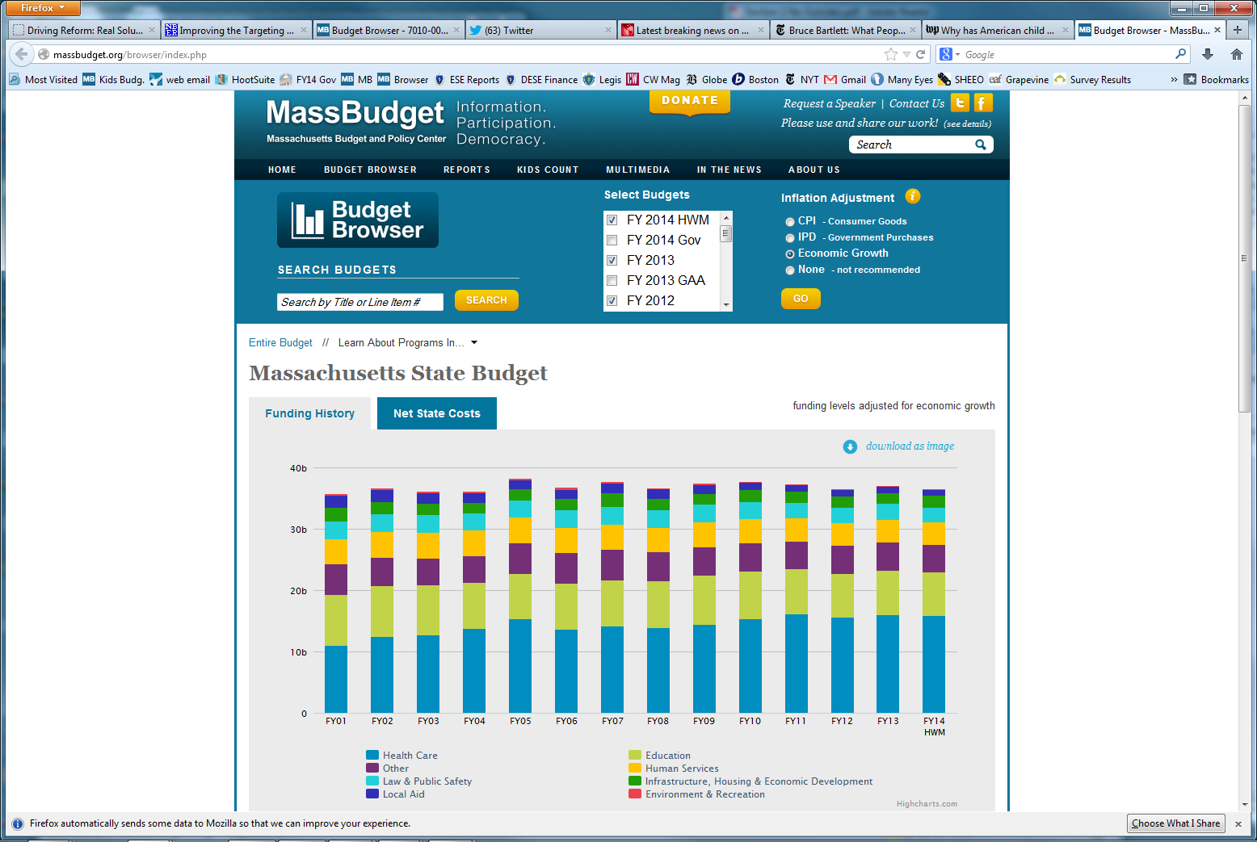
browser.massbudget.org

Slide 43
children.massbudget.org
MassBudget’s
Children’sBudget

